Slide 1
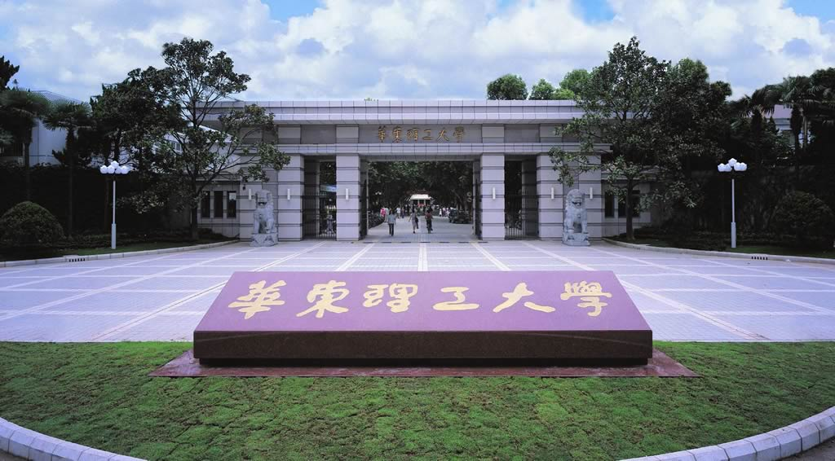
Chapter 3 Proteome Separation Techniques
Li-Qiang Fan
East China University of Science and Technolog

Slide 2
Technique for Proteome Separation1
Gel-based techniques
1D Slab Gel Electrophoresis
2D Gel Electrophoresis
Non-gel-based techniques
Capillary Electrophoresis
HPLC (SEC, IEC, RP, Affinity, etc.)
Multiple liquid chromatography
Protein Chips / Protein arrays

Slide 3
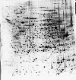

3.1 Two Dimentional Electrophoresis (2DE)
Simultaneous separation and detection of ~2000 proteins on a 20x25 cm gel
Up to 10,000 proteins can be seen using optimized protocols

Slide 4
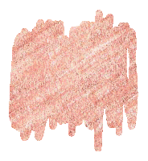
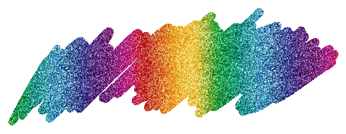
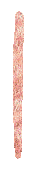


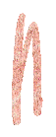


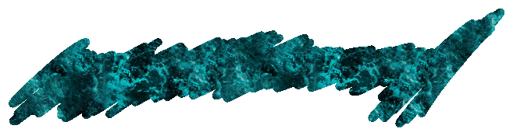


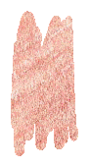

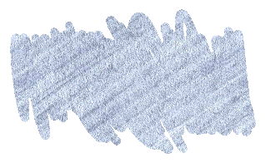
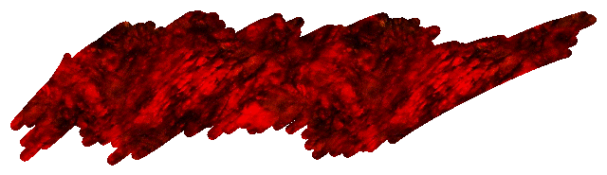



Slide 5
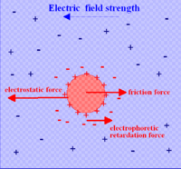
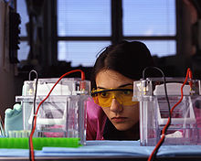

3.1.1 Protein electrophoresis
Principle
motion of dispersed charged proteins relative to a fluid under the influence of a spatially uniform electric field
Negative-charged ions (-) (anion) move toward the anode (+)
Positive-charged ions (+)(cation) move towards the cathode (-)
Molecules without charge: no move
ν=Eq/(6πrη)
Factors effect electrophoretic speed
E
Buffer pH
Ion concentration of buffer
proteins’ character
etc
Notes:
The electrokinetic phenomenon of electrophoresis was observed for the first time in 1807 by Russian professors Peter Ivanovich Strakhov and Ferdinand Frederic Reuss at Moscow State University

Slide 6
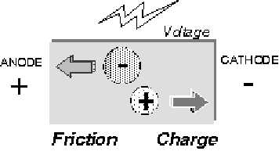





[Electric field (mV)]
[Net charge of molecule]
Mobility ~
[Friction between molecules and matrix]
Friction v.s. mobility
Size of molecules: the size bigger, move slower
Shape of molecules: the shape extender, move slower.

Slide 7
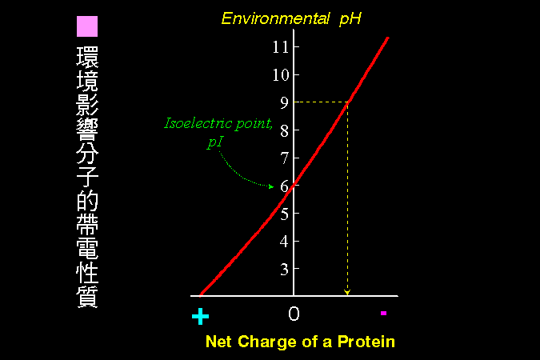
Charge of a protien

Slide 8

Exterior parameters affect mobility
Promote mobility:
Big pore size (low matrix conc.).
Low buffer conc.
High voltage apply.
High current apply.
High temperature.
Reduce mobility:
Everything opposite above.
High salt in sample.
Extreme pH of sample.

Slide 9
Proteins |  | Nucleic acids
Molecular Weight (MW) | Acrylamide Gel Concentration | Molecular Weight (MW) | Acrylamide Gel Concentration
<10⁴ | 20-30% | <10⁴ | 15-20%
1~4*10⁴ | 15-20% | 10⁴⁻⁻10⁵ | 5-10%
1-5*10^{4—}1*10⁵ | 10-15% | 10⁵—2*10⁶ | 2-2.5%
1*10⁵ | 5-10%
>5*10⁵ | 2-5%
Concentration of acrylamide（%） | Linear separation range（kD）
15 | 12～43
10 | 16～68
7.5 | 36～94
5.0 | 57～212

Slide 10
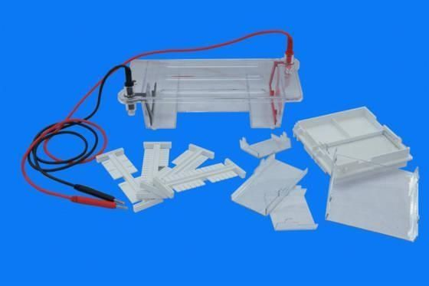
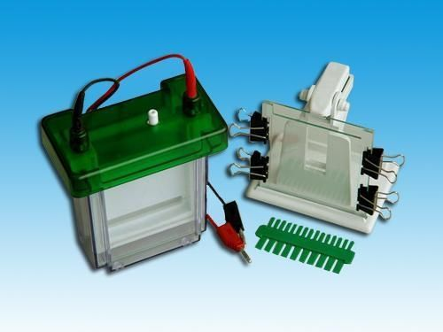
Types of electrophoresis
Based on principle
MW
pI
Based on supporting material
Filter Paper electrophoresis
Thin layer electrophoresis
chemical modified Cellulose
Gel electrophoresis
Starch
Agrose
Polyacrylamide
Based on pH gradient continuity
Continuous
Discontinuous
Based on dimentional
1D
2D
Horizontal
Vertical

Slide 11
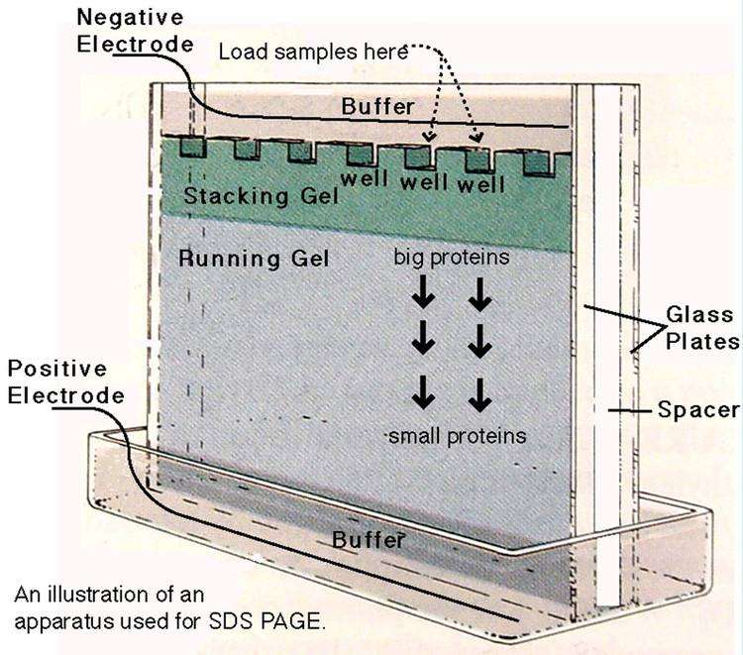
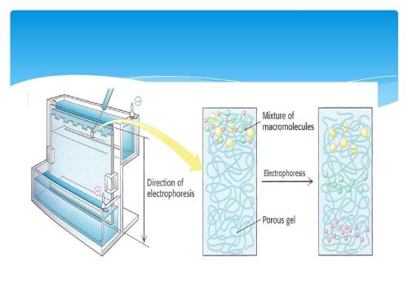

--SDS-PAGE (Most often used)
SDS -- a protein denaturing detergent that causes the molecule to unfold.
SDS: polypeptide =1:1, give protein a negative charge.
Proteins run at different rates depending on mass

Slide 12
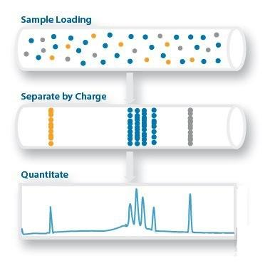
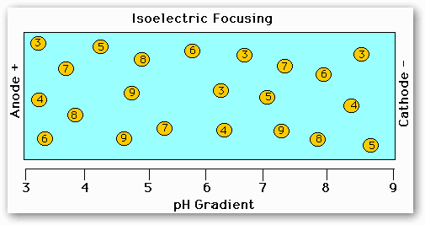
Isoelectric focusing (electrofocusing)
Separating different molecules by differences in their isoelectric point (pI)
A container is filled with a gel solution that has an increasing pH gradient.
The protein travels through the gel, obtaining or losing protons depending on its charge, gets stuck in an isoelectric position where it becomes neutral
Notes:
Gels with large pores are usually used in this process to eliminate any "sieving" effects, or artifacts in the pI caused by differing migration rates for proteins of differing sizes.

Slide 13
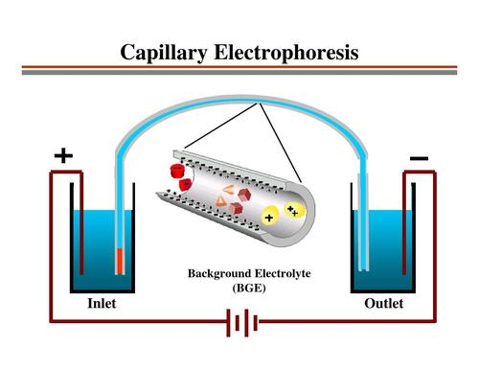

Capillary electrophoresis
A family of electrokinetic separation methods performed in submillimeter diameter capillaries and in micro- and nanofluidic channels
Separate molecules according to ionic mobility and/or partitioning into an alternate phase via non-covalent interactions.
Concentrate or "focus" analyte by means of gradients in conductivity and pH
Include
capillary zone electrophoresis (CZE)
capillary gel electrophoresis (CGE)
capillary isoelectric focusing (CIEF)
capillary isotachophoresis
micellar electrokinetic chromatography (MEKC)

Slide 14
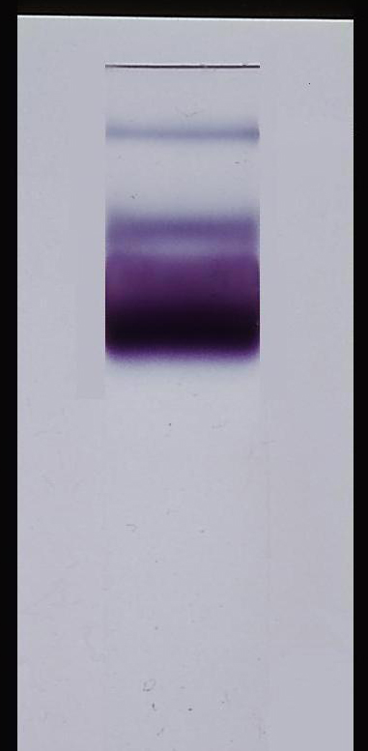

Denaturing Gels
Run run under conditions that disrupt the natural structure of the analyte, causing it to unfold into a linear chain.
The secondary, tertiary, and quaternary levels of biomolecular structure are disrupted, leaving only the primary structure to be analyzed.
The mobility of each macromolecule depends only on its linear length and its mass-to-charge ratio
Nucleic acid: urea; Proteins: SDS, beta-mercaptoethanol or dithiothreitol; RNA: Urea, DMSO and glyoxal
Reducing PAGE is the most common form of protein electrophoresis
Native Gels
Run in non-denaturing conditions, so that the analyte's natural structure is maintained
Allows the physical size of the folded or assembled complex to affect the mobility, allowing for analysis of all four levels of the biomolecular structure
Do not use a charged denaturing agent
Separate based on molecular mass，intrinsic charge, the cross-sectional area
Notes:
The Difference between native gel and denaturing gel for protein separation is that theri is no detergent SDS added.

Slide 15
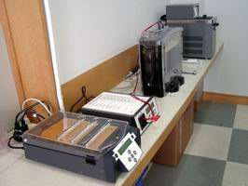


2-DE
High-resolution 2-DE is > 40 years old!
Still popular for large scale protein separation and quantification(since 1975)
Robust, increasingly reproducible, simple, cost effective, scalable & parallelizable
Permits simultaneous detection, display, purification, identification(pI, MW), quantification

Slide 16
2-DE
1st dimension
Separation by charge
(isoelectric focussing)
pI
pH 3
pH 10
2nd dimension
Separation by molecular weight
(SDS-PAGE)
kDa

Slide 17
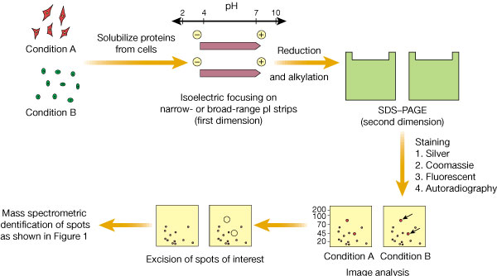
Steps in 2D GE

Slide 18
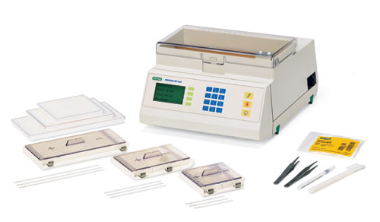
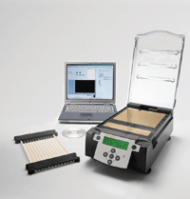
3.1.2 Isoelectric focusing
Bio-Rad
Amersham Biosciences

Slide 19



Isoelectric Focusing
Separation based on pI, not MW
Requires very high voltages (5000V)
Requires a long period of time (10h)
Presence of a pH gradient is critical
Degree of resolution determined by slope of pH gradient and electric field strength
Used to use ampholytes to establish pH gradient, now often use IPG stripts
Notes:
载体两性电解质pH梯度等电聚焦（操作比较麻烦，胶条质量标准很难控制） 固相化pH梯度等电聚焦

Slide 20
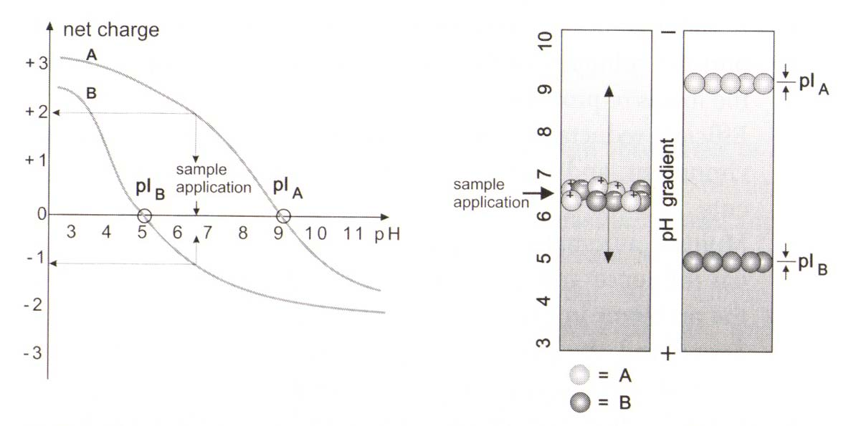
1 The principle of IEF
Proteins are amphoteric molecules with acidic and basic buffering groups.
They can be protonated or deprotonated depend on pH environment and move accordingly in an electric field.

Slide 21
IEF Principle
Increasing pH
+
+
+
+
+
+
+
+
+
_
_
_
_
_
_
_
_
_
C
A
T
H
O
D
E
A
N
O
D
E
pI = 5.1
pI = 6.4
pI = 8.6

Slide 22




2 Components of IEF Buffer
Chatotropes (Denaturing reagent)
8M Urea
7M Urea/2M Thiourea
Surfactants (Detergents)
4% CHAPS
2% CHAPS / 2% SB-14
Reducing Agents
65mM Dithioerythritol
100mM Dithiothretiol
2mM tributyl phosphine
Ampholytes: 2%

Slide 23
3 Development of IEF
ISO-DALT
First development , pH gradient formed with a carrier ampholyte in capillary
separation and detection of proteins in the capillary format
IPG-DALT
based on immobilized pH gradient (IPG) stripts
Carrier ampholyte-free isoelectric focusing on a paper-based analytical device
Carrier ampholyte-free
paper channel can be directly cut and recovered into solutions for post analysis
https://doi.org/10.1002/jssc.201701438
Micro free-flow isoelectric focusing
with integrated use of chip-integrated optical pH sensors (fluorescent or luminescent micro sensor layers)
https://doi.org/10.1002/elsc.201700035
Non-equilibrium pH gradient electrophoresis (NEPHGE)
mainly for basic/acidic protein separation
Off-gel isoelectric focusing
mainly for basic/acidic protein separation
Notes:
https://www.sciencedirect.com/science/article/pii/B9780128093757000071
Review
Counterflow gradient electrophoresis for focusing and elution
Matthew Courtney Carolyn L. Ren
First published: 17 December 2018 https://doi.org/10.1002/elps.201800376

Slide 24
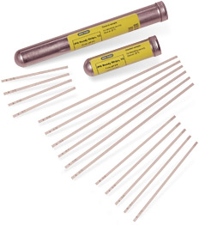
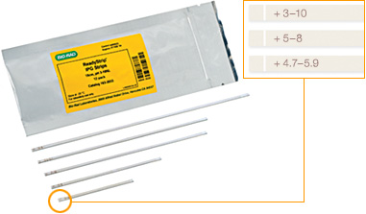
IPG Strips-- Immobiline Dry Strips
Introduced by Gorg. A in 1994
CH₂=CH-C-NH-R
||
Acrylamido buffer
O
R = weakly acidic or basic buffering group
Strip Length 7.9 cm 11.8 cm 17.8 cm
Gel Length 7.3 cm 11.0 cm 17.1 cm
Strip Width 3.3 mm 3.3 mm 3.3 mm
Gel Thickness 0.5 mm 0.5 mm 0.5 mm
pH Gradients
Standard 3-10,4-7 3-10,4-7 3-10,4-7
Overlapping 3-6,5-8 3-6,5-8 3-6,5-8

Slide 25
Ampholytes vs. IPG
Ampholytes are small, soluble, organic molecules with high buffering capacity near their pI (not characterized)
Gradients not stable
Used to create pH gradients via user
Batch-to-batch variation is problematic
An immobilized pH gradient (IPG) is made by covalently integrating acrylamido buffer molecules into acrylamide matrix at time of gel casting
Stable gradients
Pre-made (at factory)
Simplified handling
High resolution 0.001pH
High sample loading

Slide 26
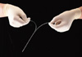
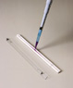
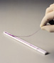
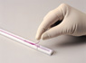
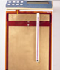
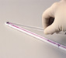

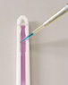
4 IEF: procedure
Prepare pH gradient
Load sample
Run sample
balance

Slide 27
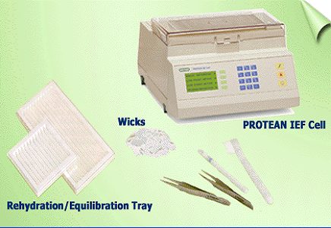

Procedure
Select IPG strips
Rehydrate dry IPG strips (12h)
Apply Sample (during or after rehydration)
Placing the IPG DryStrip into the strip holder：
Run IPG Strips (high V, low current, 20C 4h)

Slide 28
1) Select IPG strips
Short/Long pH gradient strips
7cm, 11cm, 13cm, 17cm, 18cm, 24cm
Wide range/Narrow-range pH gradient strips
Liner/Non- liner pH gradient stripts
Shorter first, longer later ;
Wide range first, narrow-range later
Liner first, non-liner later;
Notes:
先短后长、 先线性后非线性、先宽后窄

Slide 29
2) Rehydrate IPG Strips
Possive rehydration
On IEF equipment
Facilitate for large MV protein, while small ones easily go out
Negative rehydration
On rehydration tray
Facilitate for small protein, but not for large ones
Buffer: same as IEF buffer

Slide 30
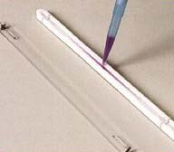
3) Sample loading
(1) Rehydration loading (In-gel rehydration)
- large sample volume (> 100 mL), large sample
amounts, more dilute samples
- No precipitation at the application point
(2) Cup-loading (at anode), for alkaline IPGs
- Max. protein conc.: 150 mg/150 mL
- Larger sample loads may lead to increased precipitation
(3) Paper-bridge loading
- Ideal for very large sample volumes
- when using basic pH intervals (pH 6-9, pH 6-11, pH 7-11)

Slide 31
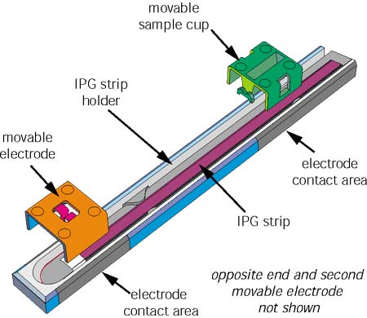
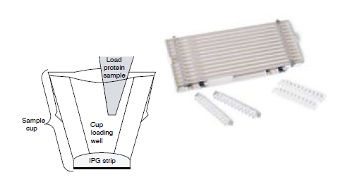

Cup- loading
Paper bridge loading

Slide 32
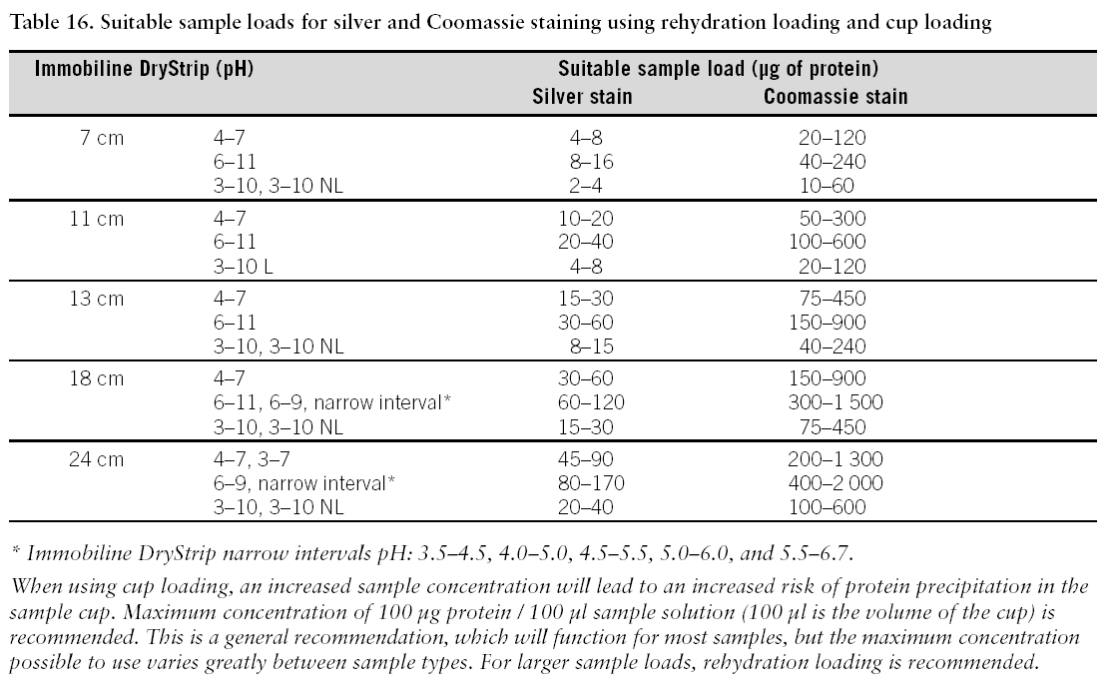
Suitable sample loads
Notes:
說明文字

Slide 33
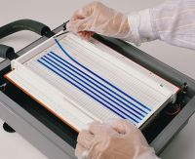
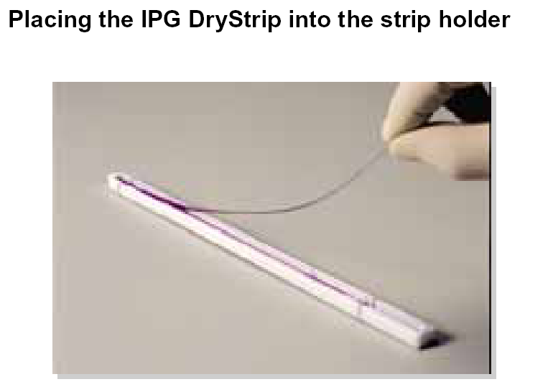
4) Place IPG strip in IEF apparatus and apply current
Notes:
說明文字

Slide 34
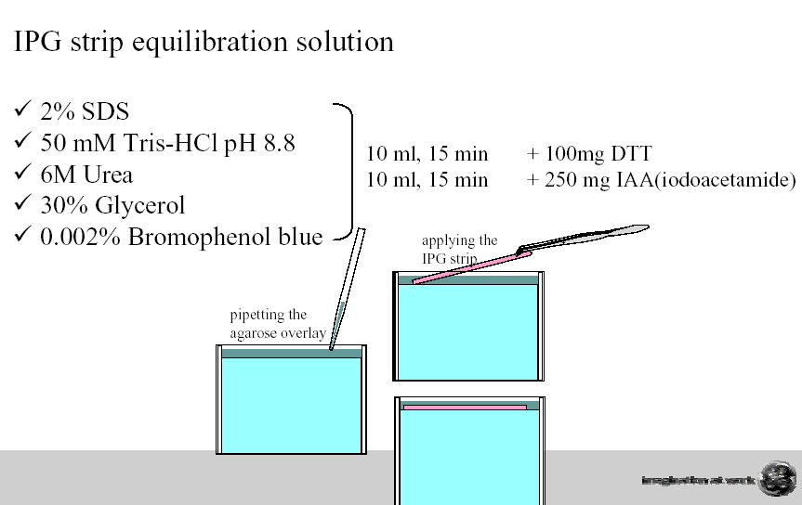




5) Strip Equilibration
Goal： To complete loading all proteins with SDS for improved protein transfer from the 1st to the 2nd dimension
Procedure：
Notes:
1) Disassamble polypeptide chains,combine protein with SDS
2) IAA Alkylation --protects –SH from oxidation, then decreasing “streaking”
Remove extra DTT, then decreasing Tailing

Slide 35
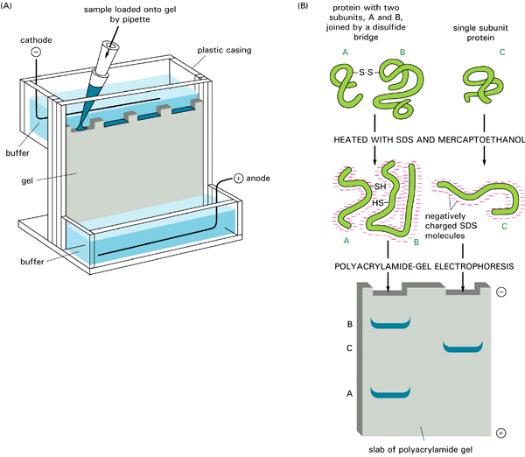
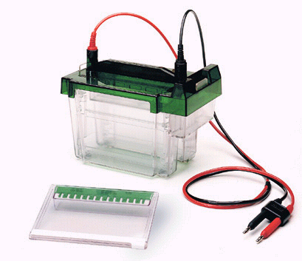



3.1.3 SDS-PAGE
Separation based on MW, not pI
Requires modest voltages (200V)
Requires a shorter period of time (2h)
Presence of SDS is critical to disrupting structure and making mobility ~ 1/MW
Degree of resolution determined by %acrylamide & electric field strength

Slide 36
SDS-- Sodium Dodecyl Sulfate
SO Na
+
1.4g SDS/g protein
4
SDS
boiling
_
_
_
_
_
_
_
C
A
T
H
O
D
E
+
+
+
+
+
+
+
A
N
O
D
E
_ _ _ _ _
_
_ _ _
_
_
_ _ _
_
_
_
_
_
_
_
_
_
_
_
_
_
_
_

Slide 37
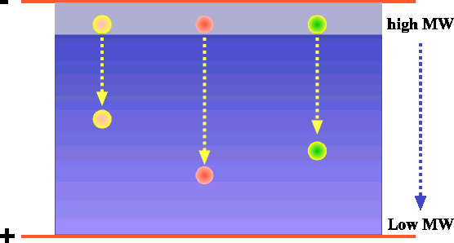
SDS-PAGE Principles
Loading Gel
Running Gel

Slide 38
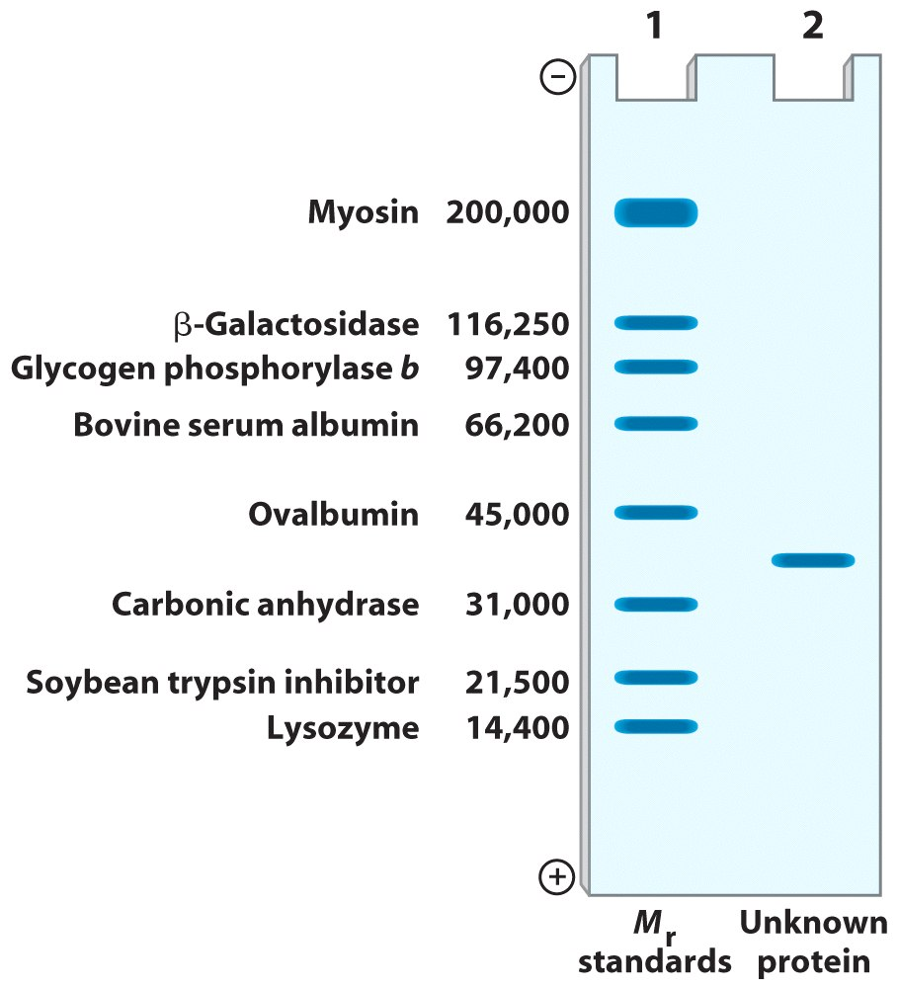
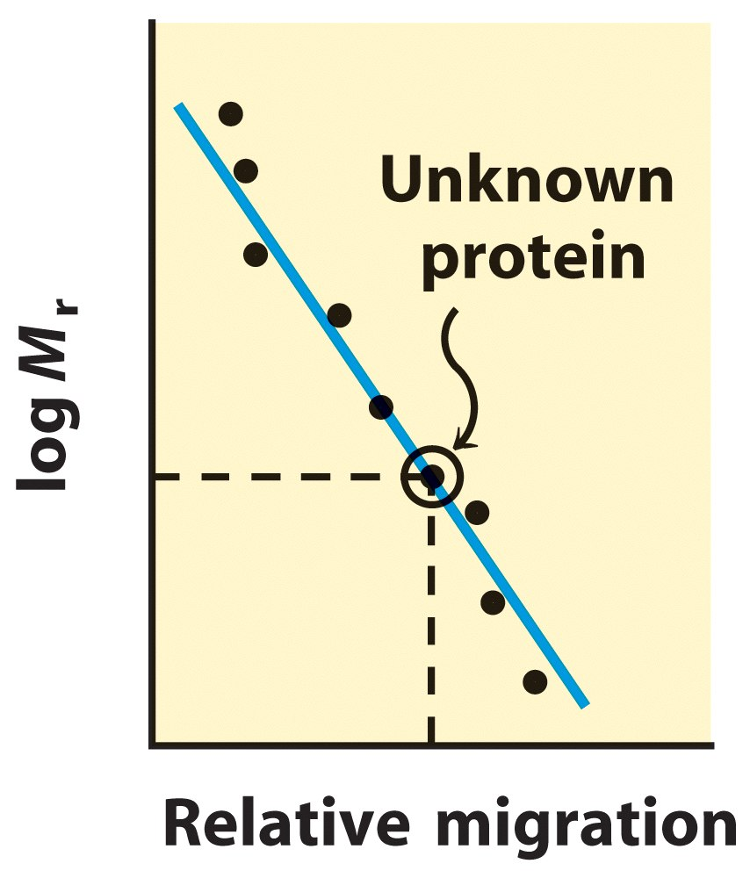
Estimating the molecular weight of a protein
Notes:
純化酵素是一件非常基本的工作，很多重要的研究，都脫不開酵素的純化工作。而大多數酵素的純化，基本上也脫不開一些最基本的原則。
首先，建立一個完善的酵素實驗室是很必要的；我們把許多實驗室內的運作細節一一交代，期望同學能認知這些經驗，確實接收並養成習慣，且期望應用到將來每個人的研究工作上。
最先遇到，但是最容易被忽視的步驟，就是材料處理及總蛋白質的抽取。將提醒你小心選擇採料的種類、時期、部位等，並選擇一個良好的粗抽取方式，以便有一個良好的開始。

Slide 39
Concentration of acrylamide（%） | Resolution Range of Separating Gel（kD）
15 | 15-45
12.5 | 15-65
10 | 18-75
7.5 | 30-120
5.0 | 60-212

Slide 40
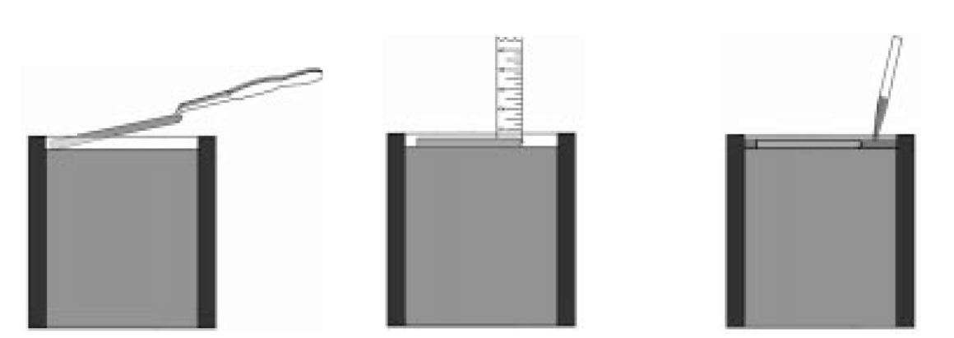



SDS-PAGE for 2D GE
equilibration
SDS-PAGE

Slide 41



2-DE instruments, 2nd dimension
Amersham Biosciences
23 x 20 cm
8 x 10 cm
16 x 16 cm

Slide 42



2-DE instruments, 2nd dimension
Bio-Rad

Slide 43

E. coli protein
Sample applied: 240 μg
pH range: 4-7
MW range: 10-120 kDa
Silver-stained
Scanned with laser scanner

Slide 44

Mouse liver protein
wide pH range gel (pH 3-12) narrow pH range gel (pH 5-6)

Slide 45

3.1.4 Visualization of proteins spots
D

Slide 46




General protein detection methods
Organic dye-based methods
Silver stain-based methods
Radioactive labeling methods
Reverse stain methods
Fluorescence-based staining methods
Chemiluminescence-based staining methods
Immobilized pH gradient /MALDI-TOF mass spectrometry and surface-enhanced laser desorption–ionization mass spectrometry (SELDI-MS)
771 (2002) 3–31 Journal of Chromatography B,

Slide 47



Coomassie Brilliant Blue Stain

Slide 48


Coomassie Brilliant Blue Stain
C H
C H
2
5
2
5
CH N
C
N CH
2
2
O S
CH
SO
3
3
3
R-250 & G-250
Procedure
Fix(50% ethanol, 10% acetic acid, 30min)
Stain(0.1% Coomassie blue R350, 20% methanol, 10% (v/v) acetic acid; 2hr)
Destain(20% methanol, 10% (v/v) acetic acid; 2hr)
Store(acetic acid is 5%)
Resolution
30ng-100 ng
N
Coomassie R-250
H C
C H
5
2
2
5

Slide 49
Colloidal Coomassie Staining
Fix the gel
(10% Acetic acid/40%Methanol)
Wash the gel with H2O
Stain the gel with colloidal Coomassie stain
50g (NH4)2SO4
6 ml 85% phosphoric acid
10 ml 5% CBG250
H2O 500 ml
Wash the gel with H2O
Resolution
8ng-10 ng

Slide 50

Silver Staining

Slide 51

Silver Staining
---The mostly used
Fixation
Sensitization(戊二醛 )
Silver impregnation( 注入 ) （ AgNO3浸泡，氨银法）
Image development（甲醛）
Stopping development and image stabilization
Problems:
Resolution
200pg --1 ng
High backgrounds, reproducibility, silver mirror
thiosulfate

Slide 52


Mass-spectrometry-compatible silver staining
Gel with Reagent A
600 ml ethanol
200 ml acetic acid
1200 ml H2O
Gel with Reagent B
6g potassium tetrathionate
98g potassium acetate
/600 ml ethanol
1200 ml H2O
Wash Gel with H2O
Gel with Reagent C
2g silver nitrate
1200 ml H2O
Wash Gel with H2O
60g potassium carbonate
600ul formaldehyde
250ul 10% sodium thiosulfate pentahydrate/2000 ml H2O
Gel with Reagent D
80g Tris & 40 ml Acetic acid/2000 ml H2O
Gel with Reagent E

Slide 53

Negative Staining
Negative staining with imidazole-zinc
Staining with colloidal
Coomassie brilliant blue G-250

Slide 54
Imidazole-Zinc Negative Staining Reagent
Gel with 1% sodium carbonate
Gel with imidazole-SDS soln’s
Wash Gel with H2O
Gel with zinc acetate soln’s
5～15min 15ng

Slide 55

SYPRO Ruby Fluorescent Staining
Gel with Reagent A
Gel with SYPRO Ruby
Gel with Reagent B
Fluorescence scanner
0.25-1ng single step, available for automation

Slide 56


Fluorescent staining vs. silver staining

Slide 57
Gel Stains - Summary
Stain Sensitivity (ng/spot) Advantages
Coomassie R-250 50-100 Simple, fast, consistent
Colloidal Coomassie 5-10 Simple, fast
Silver stain 1-4 Very sensitive, awkward
Copper stain 5-15 Reversible, 1 reagent
negative stain
Zinc stain 5-15 Reversible, simple, fast
high contrast neg. stain
SYPRO ruby 1-10 Very sensitive, fluorescent

Slide 58
不同染色方法的性能一览表
染色方法 | 灵敏度 | 活细胞应用 | 线性范围 | 与质谱兼容性 | 试剂耗费 | 对软件需求（扫描系统及其它）
考马斯亮蓝 负染 银染 荧光染料 荧光标记 磷触屏 稳定同位素标记 | 100ng 15ng 200pg 400pg 250pg 0.2pg <1pg | No No No No No Yes Yes | 3 3 7 10⁴ 10⁴ 10⁵ ? | ＋＋ ＋＋ ＋ ＋＋＋ ＋＋ ＋＋＋ ＋＋ | ＋ ＋ ＋ ＋＋＋＋ ＋＋＋ ＋＋＋ ＋＋ | ＋ ＋ ＋ ＋＋＋＋ ＋＋＋＋ ＋＋＋＋ ＋＋＋＋

Slide 59
Specific detection of protein post-translational modification
Glycoprotein detection methods
Phosphorprotein detection methods
Proteolytic modification detection methods
S-Nitrosylation detection method
Arginine methylation detection methods
ADP-ribosylation detection methods

Slide 60

Glycoprotein detection of 2-DE separated proteins
Periodic acid/Schiff staining
Digoxigenin (DIG)/AntiDIG alkaline phosphatase (AP) labeling
Lectin

Slide 61
Phosphoprotein Staining with the GelCode Phosphoprotein Staining kit
Gel with H2O
Gel with Sulfosalicylic acid
Gel with H2O
Gel with 0.5N NaOH
Gel with ammonium molybdate soln’s
Gel with methyl Green soln’s/sulfosalicylic acid

Slide 62
Detection of reporter enzymes and epitope tags
β-Glucuronidase (葡萄糖苷酸酶 )
β-Galactosidase (半乳糖苷酶 )
Oligo-histidine tags
Green fluorescent protein

Slide 63




Detection of proteins on membranes
Ponceau S
CBR250
Amido Black
India Ink
Colloidal Gold

Slide 64
3.2 Problems of 2DE and solving methods

Slide 65



Technical difficulties inherent in 2-DE:
Limited solubility of hydrophobic and membrane proteins
Limited dynamic range, and difficulties in focusing highly basic and acidic proteins
Missing proteins at very high and low molecular weight.
One gene → multiple protein spots
One single spot → several gene products
Protein abundance
Notes:
說明文字

Slide 66
Problems
Resolution
Sensitivity
Automatation
Streaks
Others

Slide 67







Trouble Shooting 2D GE
Horizontal streaks
Sample not completely solubilized prior to application on IPG, sample poorly soluble in rehydration solution, ionic impurities, ionic detergents
Vertical streaks
Insufficient equilibration, insufficient SDS

Slide 68




3.2.1 Resolution
Define: the ability to distinguish spots in a gel
Problem
Too small/close to distinguish
Solving methods
make “it” wider and bigger

Slide 69

Improving the resolution
Using bigger gels
Increase separation length in both dimension
30cm gel can tell 10000 protein spots
Using non-linear range gels
Zoom gels
Use multiple IEF gels, each with a narrow pH range, then combine them together
“Proteomic Contigs”

Slide 70


Slide 71


Slide 72

Proteins analyzed by IPG strips of different pI ranges
Notes:
說明文字

Slide 73

mouse liver proteins （2D-PAGE &silver stain)
Left: wide pH range gel (pH 3–12)
Right: narrow pH range gel, zooms in the pH 5–6

Slide 74
Proteomic Contigs
Proteomic
contig
3
7
6
10
6
7
3
10
Notes:
Proteomic Contigs（蛋白质组重叠群）

Slide 75

Improving the resolution
Using non-linear pH gradients IPG stripts
Increase resolution by flattening the pH gradient between pH 4 and pH 7

Slide 76

Improving the resolution
Problem: too complex and different protein abundance
Solving method---prefractionation
Simplify the component of the sample to get better result
Method
Sequential extraction based on solubility
Extraction based on cellular compartments (nuclei/cytoplasm)
Electrophoretic pre-fractionation
Affinity purification (chromatography)

Slide 77


Slide 78


Extraction based on cellular compartments
Human mitochondrial proteins
Human nuclear proteins

Slide 79


Slide 80


Slide 81


Fractionation/enrichment Chromatography/affinity purification
1) Size
gel filtration/size exclusion
2) Charge
ion-exchange
cation (basic proteins) and anion (acidic proteins)
3) Hydrophobic/polar
reversed phase, hydrophobic interaction, hydrophilic interaction

Slide 82

Fractionation/enrichment Chromatography/affinity purification
Affinity
specific interaction with a ligand bound to column
- “general” ligand e.g. chemical group
- immobilised metal -Histidine containing proteins
- highly specific ligand e.g.antibody

Slide 83


Importance of fractionation
Increase proteome coverage
Separate highly abundace proteins from low abundance proteins of interest and brings them into dynamic detection range
Increased chances of identifying low abundance proteins of diagnostric or therapeutic uses

Slide 84


High-Resolution Two-Dimensional Electrophoresis
Proteomics
Volume 564 of the series Methods in Molecular Biology™ pp 13-32
Date: 26 May 2009
Reiner Westermeier
Published Online: 26 FEB 2016
DOI: 10.1002/9783527695188.ch4

Slide 85





3.2.2 Sensitivity
Problem:
difficulty in detecting the rarest proteins—limited by staining sensitivity
abundant proteins dots mask or obscure scarce proteins dots
Resolve:
Zoom gel technology (narrow-range IPG gels )
prefractionation or affinity-depletion abundant proteins
Increase staining resolution

Slide 86


3.2.3 Automation
Capturing the images from stained 2D-gels and then isolating particular spots for further processing and mass spectrometry used to be hard to automate and therefore constitutes the most significant bottleneck in proteomic research.

Slide 87

Automation
There are now various software packages available that produce high-quality digitalized gel images and incorporate methods to evaluate quantitative differences between spots on different gels.
Spot excision robots use plastic or steel picking tips to transfer gel slices to micro-titer plates for automated digestion, clean-up, concentration, and transfer to the mass spectrometer.

Slide 88

Automation
spot excision robots
200–300 protein spots per hour.

Slide 89




3.2.4 Streaks
Problem
Poor solubility
Solve method –increase solubility
membrane proteins:
stronger detergents, such as CHAPS
selectively enriching the initial sample e.g. preparing membrane fractions
histones, other chromatin proteins and ribosomal proteins that are very hard to separate by standard 2DGE
modified 2DGE
modified buffers

Slide 90

Modified 2DGE : acid-urea gel --acid-urea-Triton gel
first separation carried out on an acid-urea gel (which separates the proteins on the basis of size)
the second-dimension separation carried out on an acid-urea-Triton gel (Histones with different hydrophobicity binds differentially to Triton)
Modified buffers:
to break the aggregation of nuclear proteins in 2DGE.

Slide 91
3.2.5 Specical cases
Total or part proteins
Low abundant protein
Very hydrophobic protein
Very alkaline (basic) protein
Simple sample

Slide 92
Low abundant protein
Most protein are low abundant protein, but which always have import biology functions, like regulation protein, transduction proteins and acceptors and so on
Difinition--Proteins with Codon bias index (CBI) less than 0.2
Yeast genome and proteome studies shown: more than 6000 are low abundant proteins, and 2500 proteins with CBI less than 0.1
Notes:
Codon bias index (CBI) 密码子使用偏好指数

Slide 93


How to study low abundant proteins
Problem
Too few to be detected
Block by hige abundant proteins
Solve method
Increase load amount
Use narrow range IPG
Remove large abundant proteins
Sample pre-fractionation
Lower sample complex—ProtoClear, blue dextran
Enrichment low abundant protein--Cibracan Dye
Notes:
ProtoClear 技术处理，人血浆中至少95%白蛋白和97%IgG被清除
4.2 毛细管电泳（CE）
毛细管电泳是一类以毛细管为分离通道，以高压直流电场为驱动力的新型液相分离技术。毛细管电泳具有多种分离模式：毛细管区带电泳（CZE）、毛细管等速电泳（CITP）、毛细管等电聚焦（CIEF）等。应用毛细管电泳分离多肽类物质具有柱效高、分析时间短、所用样品量和试剂少等优点。黄志东等使用 MECC在8min分离了7种肽类物质。
与高效液相色谱相比，CE的制备总量低，只适用于微量制备；对扩散系数小的生物大分子而言，CE比HPLC的分辨率高得多，因此CE被用来作为收集非常纯的单一馏分的微量制备手段。

Slide 94


Slide 95


Slide 96
Special cases
Total or part proteins
Low abundant protein
Very hydrophobic protein
Very alkaline (basic) protein
simple sample

Slide 97

Very hydrophobic proteins
Problem
Low solubility in standard method
Easy to concentrate and aggregate while isoelectric focusing, and difficult to run SDS-PAGE
Solvent
Increase solubility and keep them in solution

Slide 98
Very hydrophobic proteins
Lysis procedure
Combination of 7M Urea and 2M Thiourea
Alternative Zwitterionic detergent like ABS14 and non-detergent like sulfobetain
SDS <=2%
Pre-fractionation

Slide 99
2DE of rat liver extract
A 8M urea B 7M Urea and 2M thiourea

Slide 100
Very hydrophobic proteins
Electrophoresis steps
Extract sample with 16-BAC
First separate in acid gel at pH 2.1, then by SDS-PAGE
More hydrophobic protein shown on gel (Langen et al, electrophoresis 2000,21:411-429)

Slide 101
Special cases
Total or part proteins
Low abundant protein
Very hydrophobic protein
Very alkaline (basic) protein
simple sample

Slide 102

Very alkaline (basic) protein
Problem
Commercial IPG (pH3-10) do not suit for alkaline protein analysis
Most proteins in cell extract are acidic proteins, which have low solubility in alkaline IPG,especially with high load amount
Also belong to low abundant proteins

Slide 103

Very alkaline (basic) protein
Solve method
Use basic range IPG
NEPHGE
Pre-fractionation to remove acidic proteins
Concentration:
TCA/acetone，inactivate protease, reduce protein degradation, remove interfering substances and enrich extremely basic proteins, such as ribosomal proteins from whole cell lysates.
Increase electrophoresis effect
Increase ratio of N,N’-bis-acrmide
1-10% sorbol
16% isopropol

Slide 104
Get specific samples --Laser capture microdissection, LCA
将一张转移膜置于选取部位表面，倒置在显微镜下，用直径30µm或60µm的激光束聚焦其上，膜活化并与选取部分结合将其从周围其他组织中提取出来。
优点：富集样品使丰度更集中，定位更准确

Slide 105




Human fluids
Important source for detecting and monitoring disease
Include: Plasma,serum,cerebrospinal fluids
Problem
most of the fluids are highly loaded with abundant proteins and salt ions
Treatment
Dialysis
Low voltage isoelectric focusing
Pre-fractionation or remove abundant protein
Notes:
Remove albumin with blue dextrane or a sepharose blue column

Slide 106
Limitations of Current 2D-gel Approach
Hard to identify many important drugable family of proteins, such as
integral membrane, basic, and low MW proteins
- No good solutions to this so far
low abundant soluble proteins
- can be partially solved by pre-enrichment of samples before 2DE
> 30% of spots with multiple proteins from pI 4-7 2DE
- can be partially solved by narrow pH range isoelectric
focusing

Slide 107


3.3 non-gel based separation methods
Capillary Electrophoresis
2D-LC-LC

Slide 108




3.3.1 Capillary Electrophoresis (single & tandem)
Capillary Electrophoresis(CE), also called high performance capillary electrophoresis (HPCE,) or capillary electrophoresis seperation method (CESM)
In 1981, it was developed by Jorgenson and Lukacs based on electrophoresis
Principle
Based on the movement of charged compounds inside a background electrolyte under an applied potential
Often performed in narrow capillaries at atmospheric pressure
Notes:
毛细管电泳，又称为高效毛细管电泳，或毛细管分离法

Slide 109
Comparation of CE and HPLC
Samilarity :
High efficiency separation technology
Instrument operation can be automated
Have a variety of different separation mode
Difference
CE uses migration time instead of the retention time in HPLC
CE assay is faster than HPLC, with the analysis time no more than 30min
The column effect of CE is much higher than that od HPLC
Sample amount: CE, nl or 270fl; HPLC, μl
mobile phase: CE, few ml; HPLC, over 100ml
CE can only be used for micro preparation, and HPLC can be used as a constant preparation

Slide 110

3.3.2 2D - LC/LC
Chromatography: any separation technique that distributes the components of a mixture between two phases, a fixed stationary phase and a free-moving mobile phase
Principles of liquid chromatography
Molecules with the lowest affinity for the stationary phase will move the most quickly because they tend to remain in the solvent, while molecules with the highest affinity move the most slowly because they tend to stay associated with the stationary phase and are left behind.

Slide 111
Chromatography
Property
Size
Charge
Hydrophobicity
Affinity
Method
Gel-filtration
Ion-exchange
Hydrophobic interaction
Affinity chromatography

Slide 112
Affinity Chromatography
Beads containing
Antibody
glutathione
immobilized metal
Used to isolate protein
from a complex mixture
Containing GST tags
phosphoproteins/peptides, proteins with oligo-histidine affinity tags and other negatively charged proteins

Slide 113

Application of chromatography in proteomics
Prefractionate sample
separate the peptide mixtures from single excised spots
replace 2DGE to separate sample

Slide 114

replacement for 2DGE for the separation

Slide 115

2D - LC/LC
Peptides all bind to cation exchange column
Study protein complexes without gel electrophoresis
(trypsin)
Successive elution with increasing salt gradients separates peptides by charge
Peptides are separated by hydrophobicity on reverse phase column
Complex mixture is simplified prior to MS/MS by 2D LC

Slide 116
Multidimensional liquid chromatography
Advantages
Allowing loading of large sample volumes
easier to detect low abundance proteins.
Easy to separate difficult proteins, e.g. membrane proteins, very basic proteins
Do not need to stain
Easy to couple with MS for automation
Disadvantages
Lose visual aspects of 2DE separation
lose pI and molecular mass data shown on gel

Slide 117

2D-LC-MS
Multi-Dimensional Protein Identification Technology (MudPIT)
SCX
RP
Denatured
Protein Complex
Digested
Peptides
2D chromatographic
separation of peptides
Identify proteins
in complex
Tandem
Mass Spectrometry
Link et al. Nature Biotech. 1999, 14, 957

Slide 118

Two-dimensional Orthogonal HPLC Separation
MudPIT Cycle
1) load sample
2) wash
3) salt step
4) wash
5) RP gradient
6) re-equilibration
7) go to step (3)
Buffer A
B
C
D
SCX
RP
Sample
Mass Spectrometer

Slide 119
Strategies for multidimensional liquid chromatography in proteomics
Discontinuous multidimensional system
Continuous multidimensional system
Biphasic columns

Slide 120
Discontinuous multidimentional system
Fractions were collected from the ion exchange or gel filtration column and then manually injected into the HPLC column.
The fractions eluting from the first column can be stored off-line indefinitely, and fed one-by-one into the second column, eliminating the time constraint.
Large sample volumes can be applied to the first column in order to obtain sufficient amounts of low-abundance proteins for analysis in the second dimension.

Slide 121


Discontinuous MDLC

Slide 122
Continuous MDLC system
Use an automatic fraction collection system and a column-switching valve.
Fractions collected from the first column across the elution range, and the switching valve can bring the RP-HPLC column in line to receive the fractions sequentially.

Slide 123

Continuous MDLC

Slide 124
Continuous MDLC
First dimension:ion-exchange, size exclusion and chromatofocusing
Second dimension: RP-HPLC or CE
Advantages
Speed
resolution
Automation
increased sensitivity
better representation of membrane proteins

Slide 125
Biphasic column technique
Biphasic column technique was pioneered by Link and coworkers as direct analysis of large protein complex (DALPC) and was modified by Yates and colleagues into a system called multidimensional protein identification technology (MudPIT).

Slide 126

Biphasic column
The distal part of the column is filled with reversed-phase resin and the proximal part with another type of matrix.
As long as the elution solvents for each type of resin do not interfere with each other, this allows the stepped elution of fractions from the first resin and the gradient elution of second dimension fractions from the second.

Slide 127

Peptide mixtures loaded onto the ion exchange resin are eluted using a stepped gradient of salt, resulting in the release of
first-dimension fractions into the reverse-phase resin.
Second-dimension fractions are then eluted from the reversed-phase resin into the mass spectrometer using a gradient of acetonitrile.
When this method was applied to the
yeast proteome, over 5000 peptides could be assigned to a total of 1484 yeast proteins, representing about (1/4) of the yeast proteome.

